Slide 1
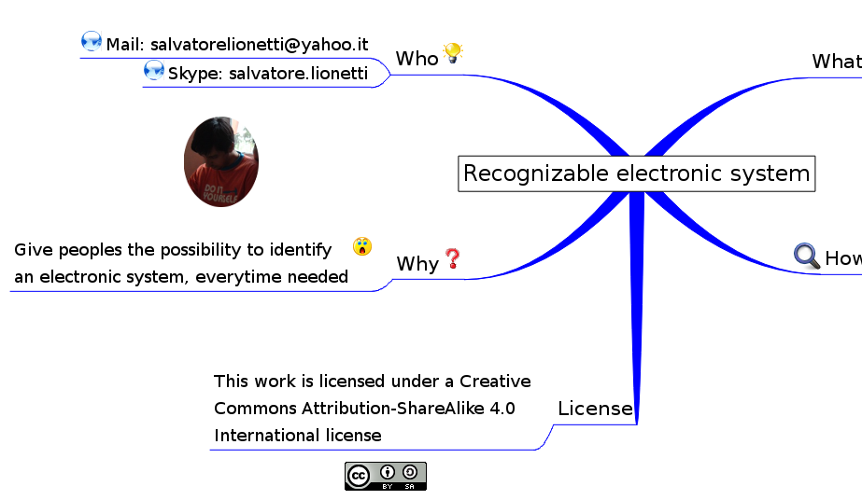
Recognizable electronic system

Slide 2
Why
Give peoples the possibility to identify an electronic system, every time needed
Annoyed to be identified by computers? Read on, it's your time

Slide 3
How
An Identification procedure that:
  statically verify HW and SW
    Computing a checksum
    inspecting the system by eye or by photo
  use cheap and fast procedures
    making the verification possible
      on running system with low impact
      by the highest number of peoples
and Architectural constraints:
  Hardware
  Firmware
  Software

Slide 4
How
Hardware
    Physical memory for storing SW, from bootloader up to kernel and application, should be nonvolatile and pluggable
    Run-time data should be stored on a physical memory other than that used for SW
    HW protocols adopted should be (wired?) master initiated (ex. USB) the master should be a "recognizable system"
    Physical memory for storing SW should have a physical WriteProtect
    The case should be transparent and simplify physical access to the board
    The board should be as simple as possible, ideally built around a SOC

Slide 5
How
  Firmware
    in core components, embedded or not in HW, like FPGA, should be absent or very limited
  Software
    Full access to source code is required. With closed source the system couldn't be recognized, it could be trusted, but this is another story

Slide 6
Who
salvatorelionetti@yahoo.it (mail)
salvatorelionetti (LinPhone, Telegram)
salvatore.lionetti (Skype)

Slide 7
License
This work is licensed under a Creative Commons Attribution-ShareAlike 4.0 International license

